Slide 1
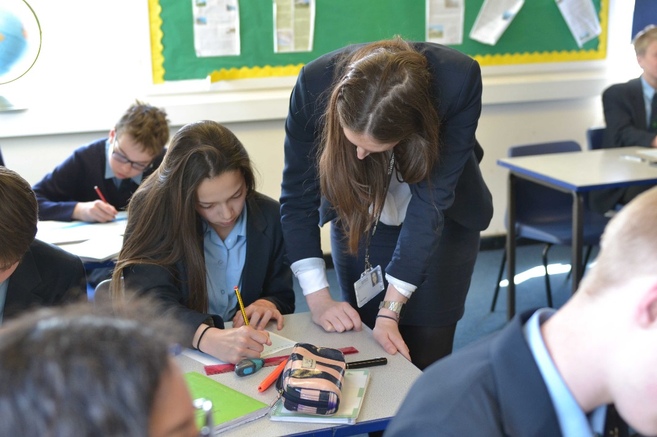
Assessment and Exam Preparation Evening

Slide 2
Aims of the evening
To provide you with an overview of how pupils are assessed in Year 7.
To provide you with information about end of year exams.
To provide parents, carers and guardians with advice and support on how to prepare pupils for sitting exams.
To provide you with further information about upcoming curricular and super curricular opportunities on offer.

Slide 3
Curriculum Intent
At Glenthorne our fundamental aim is to provide an Outstanding, Innovative & Inclusive education that enables “Achievement for All” through a curriculum that challenges, inspires and supports every pupil to:
Secure excellent academic outcomes to maximise their future life chances
Engage in broad, deep and powerful knowledge-rich learning in lessons, enriched by participation in a wide range of extra and super-curricular opportunities to enable exploration of the unfamiliar
Develop effectively the skills, qualities and habits required for success in Future Education, Employment & Training*
Understand their cultural, social, moral and personal development
Notes:
Link to curriculum vision

Slide 4
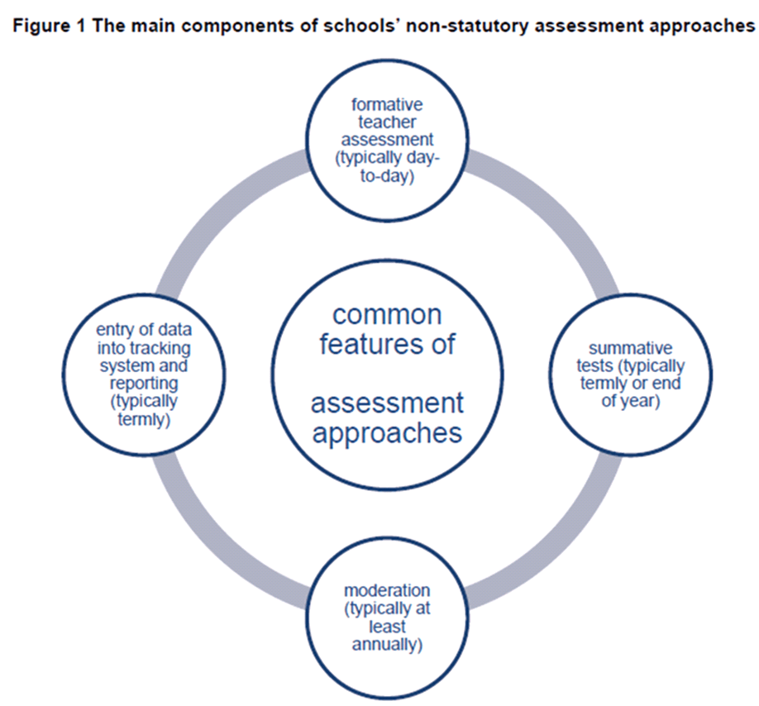
Notes:
Introduce aims

Slide 5
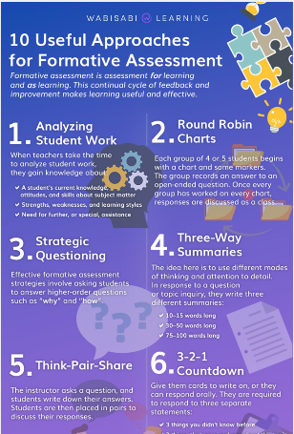
Formative assessment
Analysing student work – classwork, homework, short tests, quizzes
Round robin charts
Strategic questioning
3 way summaries
Think Pair Share
Quizzes
Low stakes skills/knowledge tests
Thumbs up or thumbs down
Mini Whiteboards
Questioning in class
Pupil self assessment
Homework
Open book tasks
Notes:
This is a slide from the first INSET day in September 2019 I used…allows follows on the from CPD afternoon led by SWR when we looked at remote assessment strategies in assess pupils. We are now back in a very different environment where pupils are back in school and preparing again for summer exams….lots of these strategies however are transferable and useful.
I would just like you to take a couple of minutes just to turn and talk to the person next to you about if you regularly use any of the strategies on the board, or similarly if there are any of the board that you wouldn't use. Perhaps as an Extra Challenge you could give an example of HOW you use it within your subject area.
__________________________________________________________________________________________________________________________________________________
Analysing student work - This is especially so if the students are required to explain their thinking. When teachers take the time to analyse student work, they gain knowledge about:
A student's current knowledge, attitudes, and skills about subject matter, strengths, weaknesses, and learning styles, need for further, or special, assistance. This approach lets teachers modify their instruction to be more effective in the future.
3 way summaries - The idea here is to use different modes of thinking and attention to detail. Students can work in groups or individually. In response to a question or topic inquiry, they write three different summaries:
10–15 words long
30–50 words long
75–100 words long
You can even have students use Twitter. Chances are you've got a lot of students who use it already. They'll have experience communicating messages with minimal wording and characters.
Think Pair Share –
his is one of the many formative assessment strategies that is simple for teachers to use. The instructor asks a question, and students write down their answers. Students are then placed in pairs to discuss their responses. Teachers are able to move around the classroom and listen to various discussions. It lets them gain valuable insight into levels of understanding.
You can also ask them different kinds of questions. These are suggestions, so feel free to make up your own.
Based on lesson observation feedback =
Teachers typically use formative assessment to inform their planning of the next few lessons
By having appropriate strategies in place for formative assessment this enables teachers to differentiate activities, refine their planning and provide support more effectively. This particularly shows evidence of whether pupils have mastered a topic, showing they have a deeper understanding of topics, rather than focusing on progressing as quickly as possible.
Sharing lesson objectives explicitly with pupils so they are better informed about the specific aspect of performance they need to work on.
To develop a mastery approach to learning, teachers encourage pupils to set their own individual learning objectives in response to feedback from teachers or peers. This was said to have helped pupils to have a deeper understanding of what they needed to do next to improve.

Slide 6
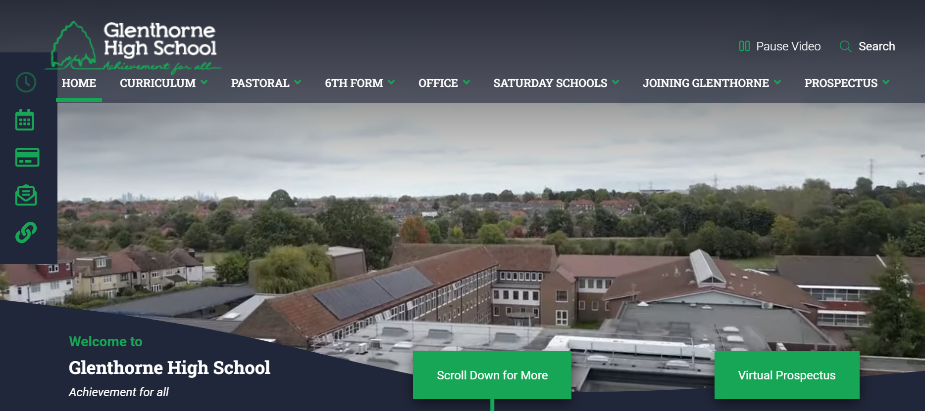



Slide 7
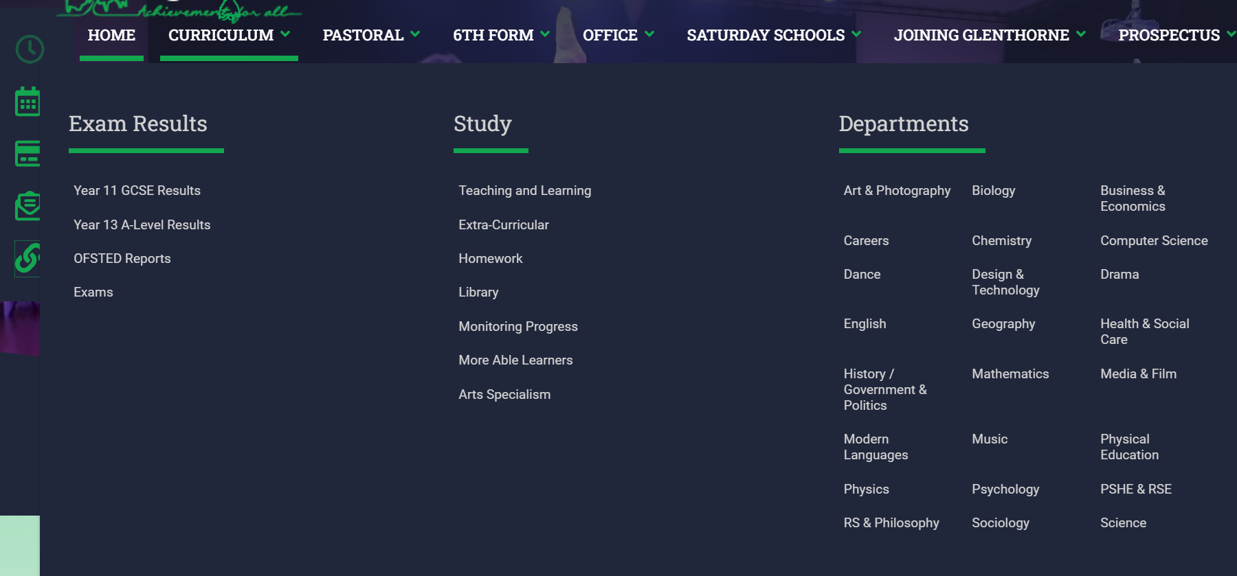


Slide 8
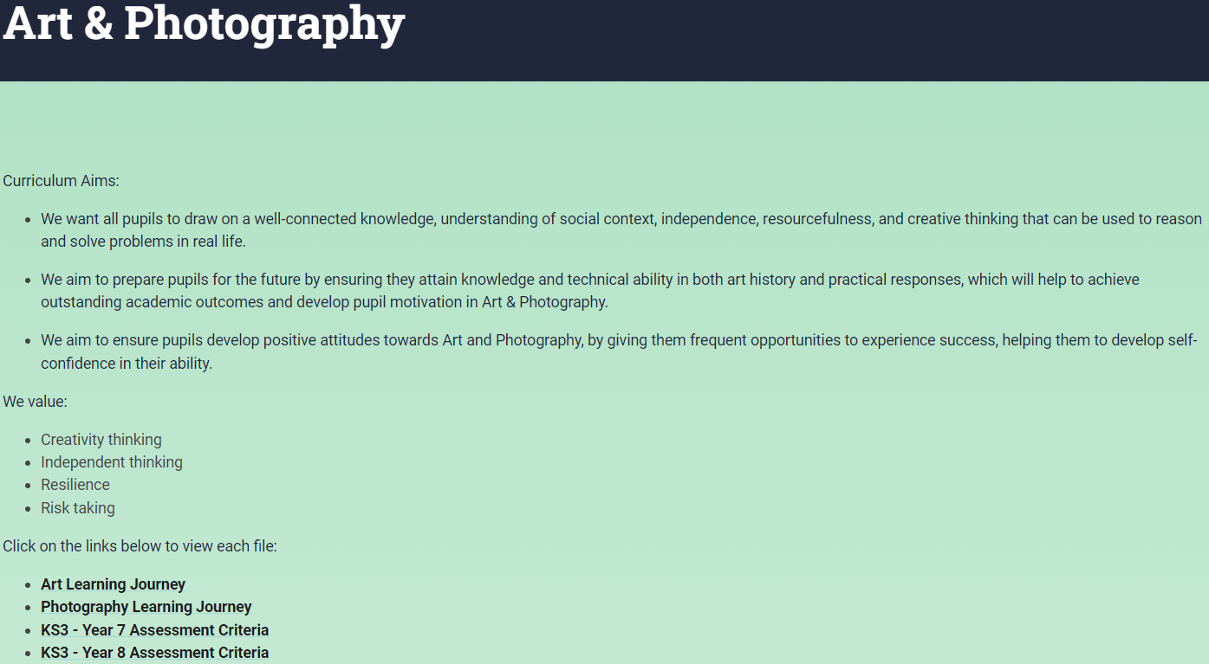


Slide 9


Slide 10
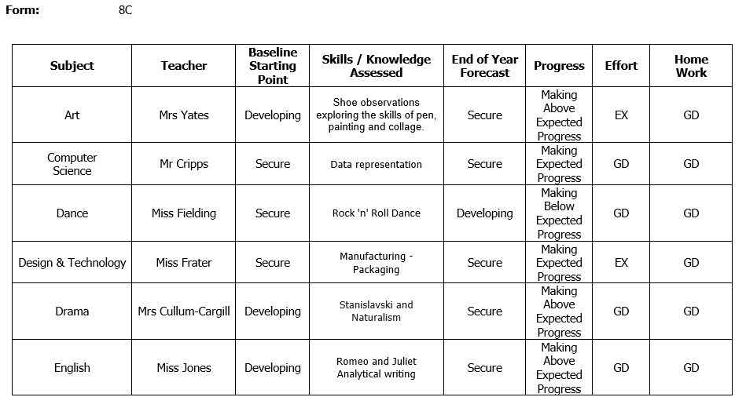
Exemplar Report

Slide 11
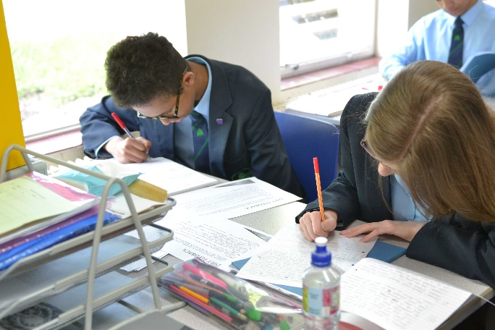
KS3 Exams
Monday 3rd June to Friday 28th June.
Sat in classrooms.
A blank on the timetable indicates that pupils will have normal lessons.

Slide 12
Why do we have exams weeks?
An effective means of assessing what pupils are able to do after a year of learning.
To identify gaps in prior knowledge.
To gather information about which teaching group would be appropriate for future years.
Preparation for public examinations.

Slide 13
GCSE Assessment for a Year 11 Pupil
In the summer of 2023 pupils can take GCSEs in:
–English Language -Two 1¾ hr exams
–English Literature –One 2¼ hr exam, one 1¾ hr exam
–Maths –Three 1½ hr exams
–Combined Science -Six 1¼ hr exams
–Spanish –One 45 min exam, one 35min exam, one 1hr 10min exam, plus speaking exams
–RS -Two 1 hr exams
–Product Design –One 2 hr exam (50%), plus 50% NEA
–History –Two 1¾ hr exams
–Drama –One 1 ¾ hr exam (40%), plus 60% NEA
TOTAL NUMBER OF EXAMS -22
TOTAL EXAM LENGTH -33 HRS
YEAR 11 SUMMER EXAMS REPRESENT 86.5% OF TOTAL GCSE ASSESSMENT

Slide 14
3 steps to success
Find out what you need to know
Prepare your revision materials
Test yourself

Slide 15


Slide 16
Preparing your revision materials

Slide 17
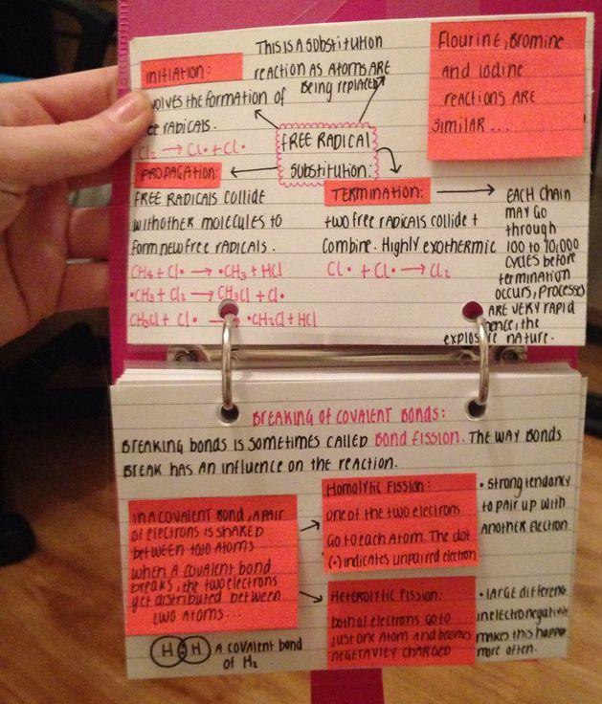
Revision cards
How can they be used?
Write questions on one side and answers on the other, then test yourself or ask someone else to test you
Write key names or terms on one side and a summary of what they mean on the other side
Write the advantages of something on one side, and the disadvantages on the other
Reduce your notes to bullet point form

Slide 18

GCSE PE: Endurance methods
Prepare revision cards in a question and answer format.
This way you can give them to someone else to test you.
Interval training: What are the advantages?
You can mix aerobic and anaerobic exercise, which is important for team games
It makes it easier for a coach to see when the athlete isn’t trying
GCSE PE: Endurance methods
Interval training: What are the disadvantages?
It can be hard to keep going when you start to get tired
The activity can become repetitive and de-motivating

Slide 19
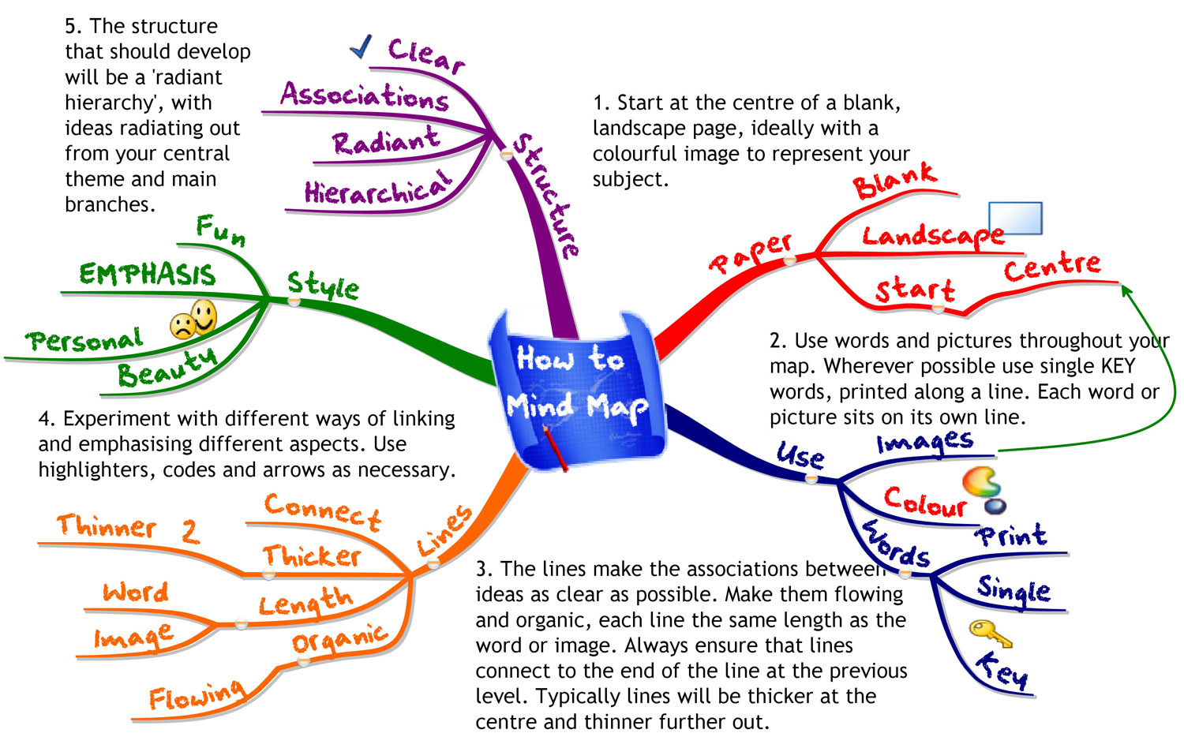
Mind maps (or ‘Concept maps’)
Mind maps are a way of organising ideas about a topic. A mind map usually starts with a central idea with a series of branches, each relating to one section of the main idea.
Stick them up somewhere at home
Spend some time learning the mind map, turn the paper over and see if you can remember it well enough to copy
Use mind maps to plan essays. Put the title in the centre, then have one branch for each key point and use further branches to develop those points
Notes:
Your subject or essay title in centre
Ideas radiate out from central theme and main branches
Here are some GCSE examples…

Slide 20
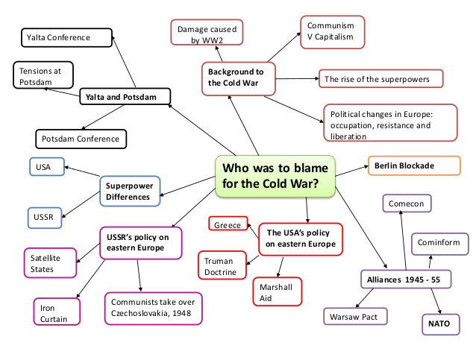
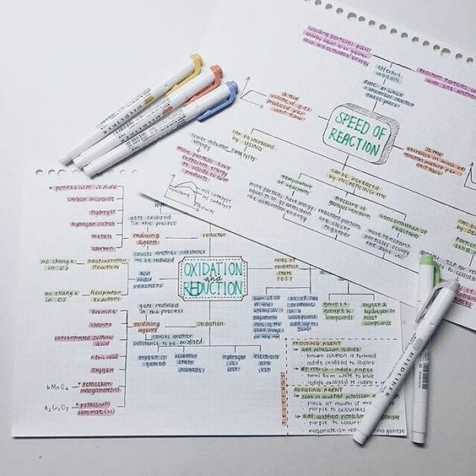
Notes:
As we’ll see in a moment, this is still an example of preparing revision notes. When you are revising I would recommend doing something slightly different with mind maps which I’ll come on to in step 4.

Slide 21
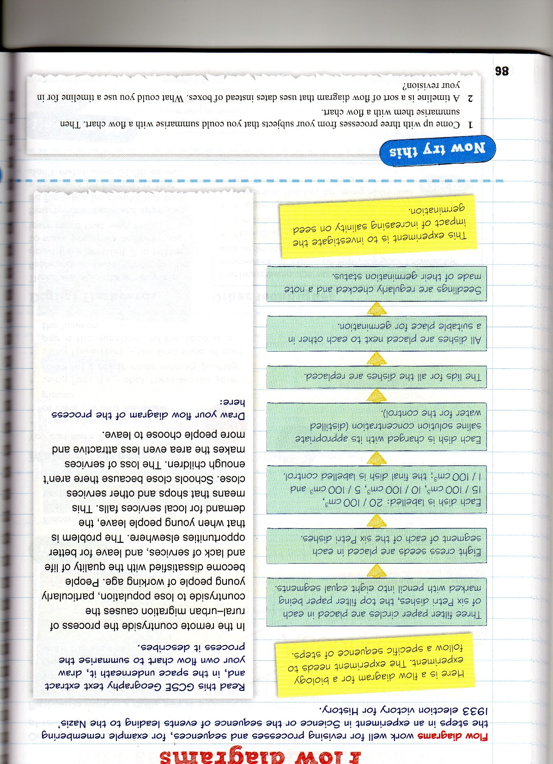
Flow diagrams work well for revising processes and sequences, for example remembering the steps in an experiment in Science, or a sequence of events in History. Read this GCSE Geography text and on the right, draw your own flow diagram to summarise the process it describes:
People become dissatisfied with quality of life in the countryside.
They leave for better opportunities elsewhere.
The demand for local services falls.
Shops and other services close. Schools close because there aren’t enough children.
The loss of services makes the area even less attractive.
More people choose to leave.
Notes:
Flow diagrams work well for revising processes and sequences

Slide 22
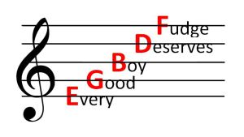
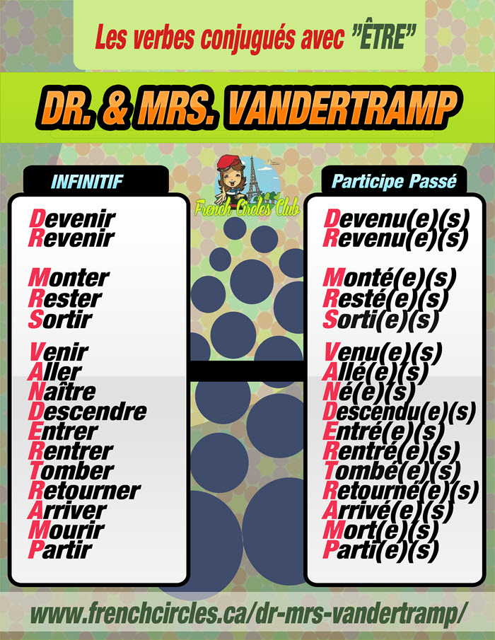
Mnemonics either replace the first letters of a sequence with a memorable phrase, or they take the first letters of a group of words and arrange them into a memorable word or words.
What are mnemonics? How can they help with revision?
Notes:
Mnemonics either replace the first letters of a sequence with a memorable phrase, or they take the first letters of a group of words and arrange them into a memorable word or words.

Slide 23
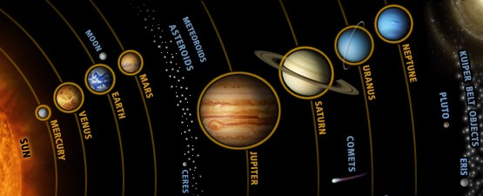
How can the mnemonic ‘My Very Excellent Mother Just Served Us Nachos’ help you to remember the order of the planets?

Slide 24
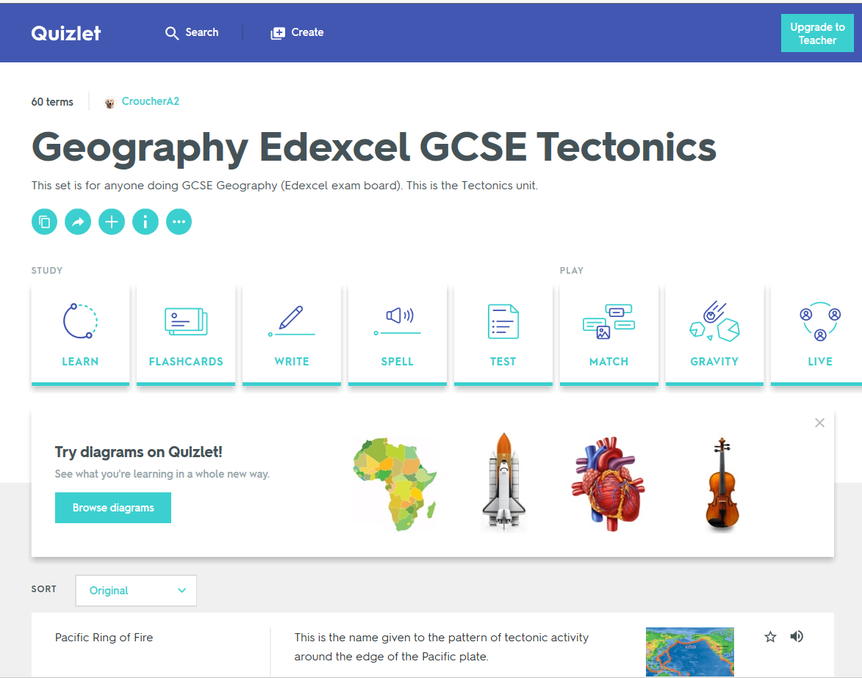
Quizlet
Upload key terms and definitions to Quizlet (www.quizlet.com).
You can share quizzes with your friends, and there are materials for many topics already on Quizlet

Slide 25
Revision isn’t….
Reading through notes
Highlighting notes or photocopies
Copying out your notes again and again
NONE OF THESE ACTIVITIES REQUIRE THINKING…
YOU WILL ONLY UNDERSTAND AND REMEMBER SOMETHING IF YOU HAVE TO THINK HARD ABOUT IT
Notes:
Our Year 12s talked about several strategies we’ve looked at already – knowing the exam requirements, preparing revision cards and post its. Before we talk more about how to revise, let’s think about what revision isn’t

Slide 26
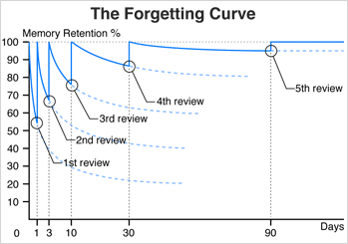
Revision = testing yourself
Ask someone to test you on your revision cards
Test yourself on revision quizzes that you have prepared on Quizlet
Complete mind maps or flow diagrams from memory
Make sure that you keep going back to topics that you are feeling less confident about

Slide 27

Organisation
Suitable space
Clear idea of what it is that needs to be revised (i.e. areas of weakness)
Complete sets of well organised and easily accessible notes, books and resources.
Must be planned as an active process
Breaks and physical exercise are essential

Slide 28

Time management
Creating a timetable is crucial.
Ask your child how they plan to use their time.
Little and often is the most effective approach.
There should always be a clear aim for the session, e.g. ‘I will be able to explain the factors which effect photosynthesis’.

Slide 29
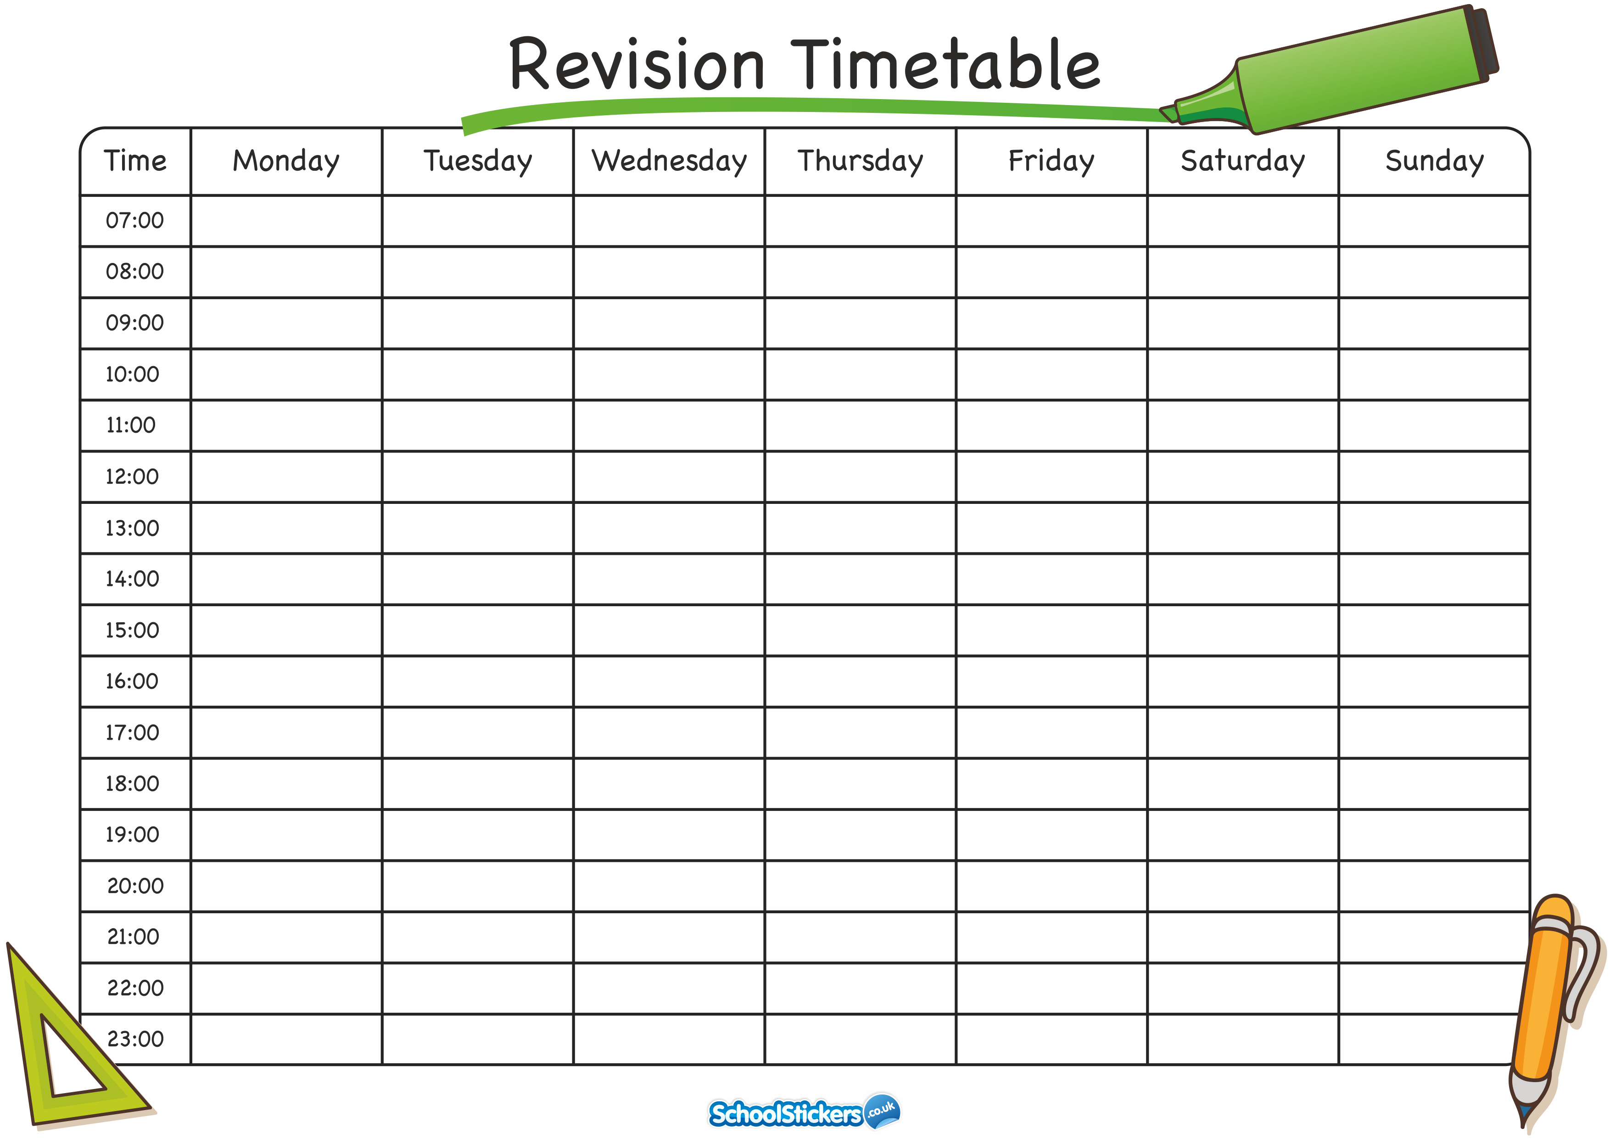

Slide 30
Watch out for…
Passive revision techniques
Other bad habits (e.g. too much time on phone or social networks). These are very difficult to challenge and address later.

Slide 31
During the exams
Your child will certainly be anxious to do well in the exams; try not to exacerbate this! They will be keen to please you and us.
They should get plenty of exercise, sleep and eat healthily.
Small rewards for hard work may work well.

Slide 32
Further advice
Please contact the school (via or Subject Leaders) if you have concerns about any subject area or revision in general.

Slide 33
Wellbeing
Pastoral Team – Tutors, AHOY, HOY
House Buddies – Sixth Form Mentors
Pastors Group Support or 1:1 Listening Support
Emotional Wellbeing Practitioners
Drop in sessions with the school counsellor
Exam stress workshops
Referrals for more specific support if needed

Slide 34
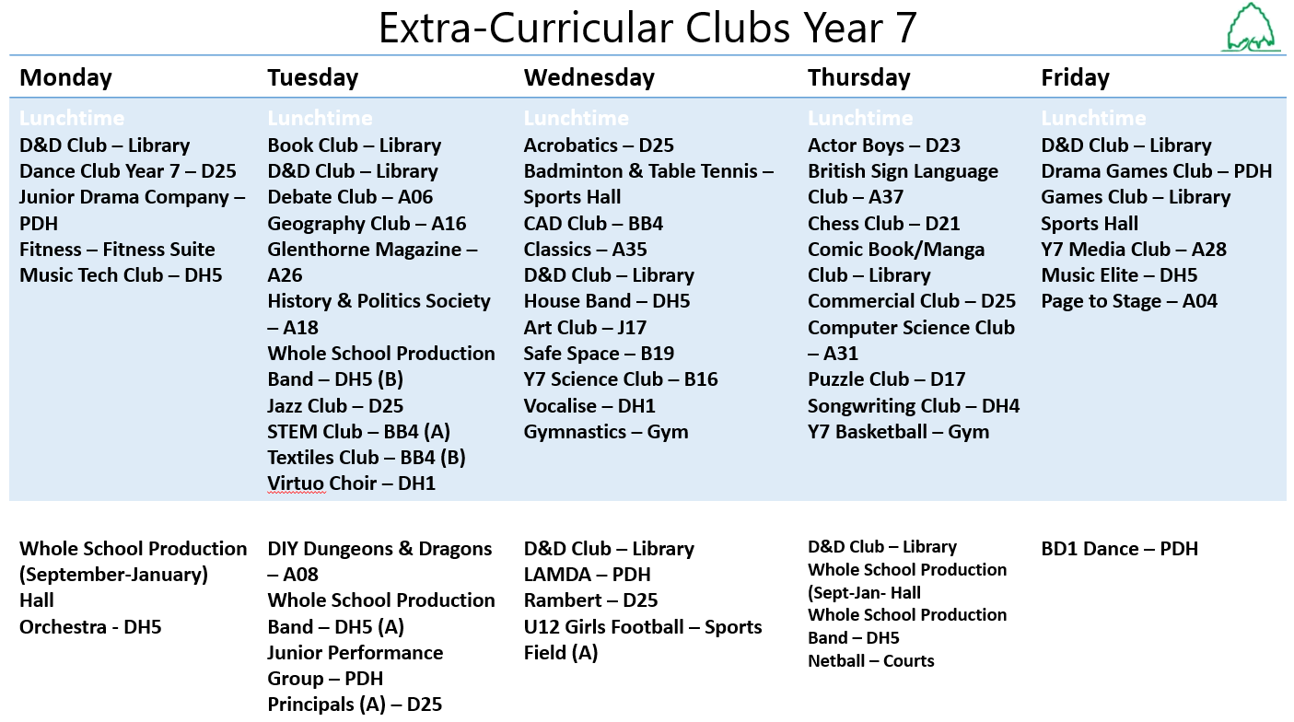

Slide 35
Extra Curricular Opportunities
Challenge Week
  Bushcraft Trip
  Bronze Arts Award

